Slide 1
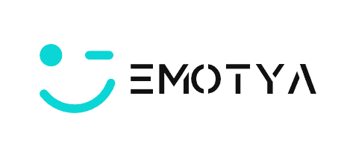

Emotya Presentation
Aleksander Kosiak

Slide 2
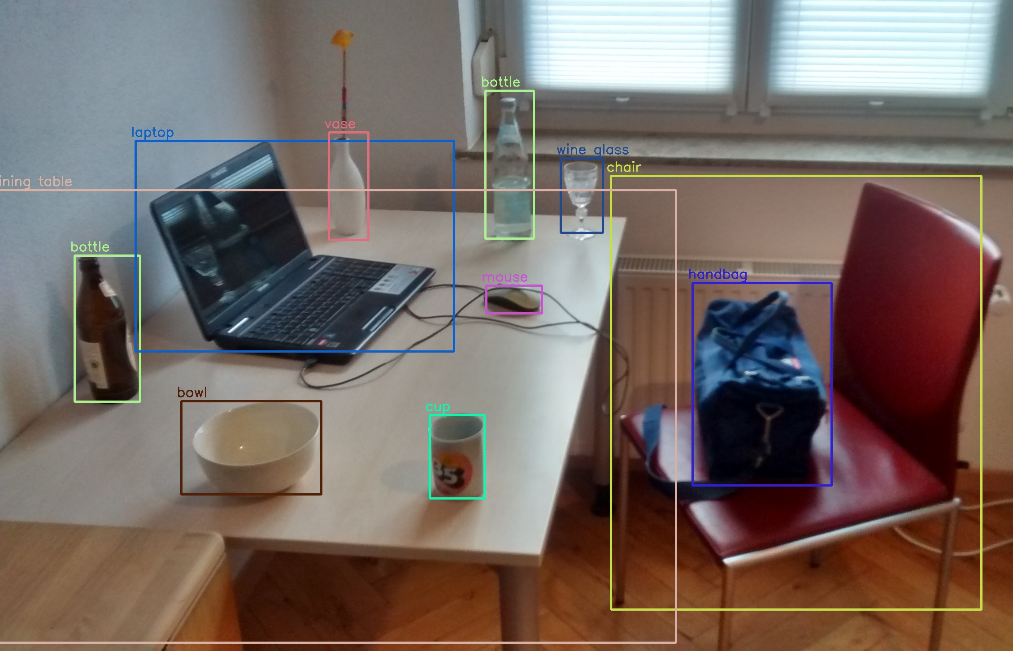
The Idea
Came from working in an object classification workplace.
Broaden horizons exclusively in face and emotion detection.
A universal application that displays our emotions on a website.
Improve QoL. IE: Mental disease diagnosis, interviews.

Slide 3
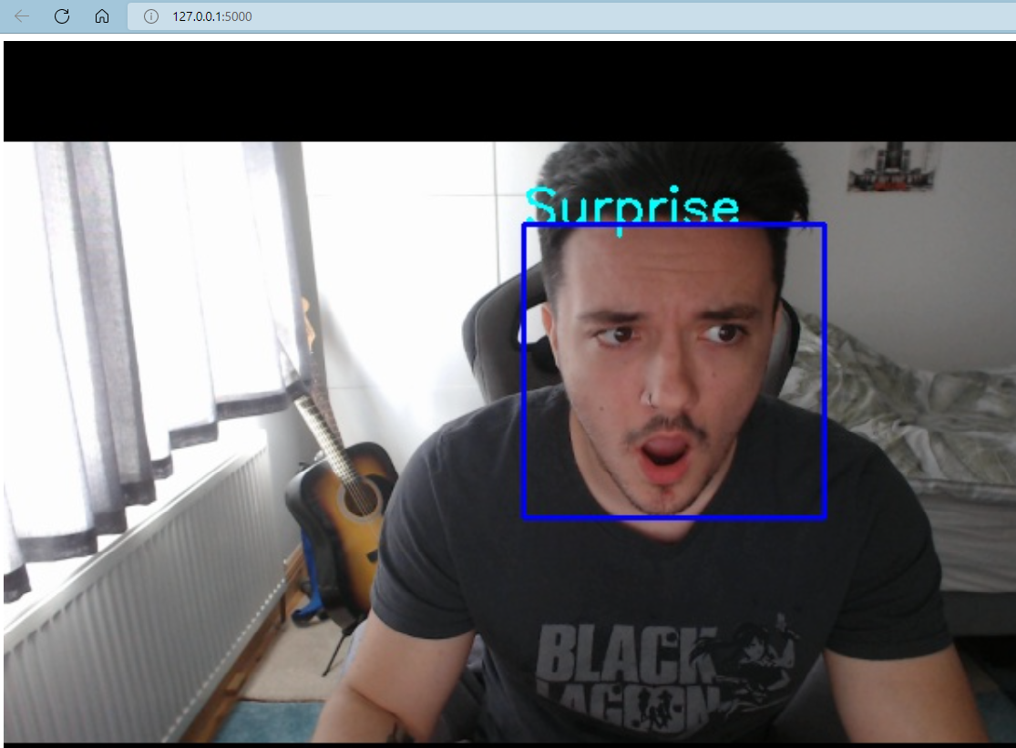
The Execution
To create a working app, multiple libraries must work in unison. IE: Keras, OpenCV, Flask
OpenCV, responsible for grabbing frame of video feed and manipulating it.
Flask, creates the webpage to view the application working.
Keras, very important in predicting emotion classification given from the image against trained model.

Slide 4
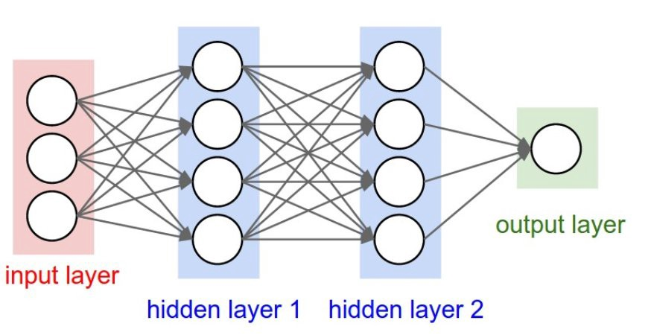
Deep Learning - Keras & Models
What is a Model?
- Neural network, like the brain.
- Multiple layers, input – hidden – output
- Nodes - Parameters
Image dataset used to train the model
Filters are Model Weights in the hidden layers. – Convolution – Flatten – Dense to name a few

Slide 5
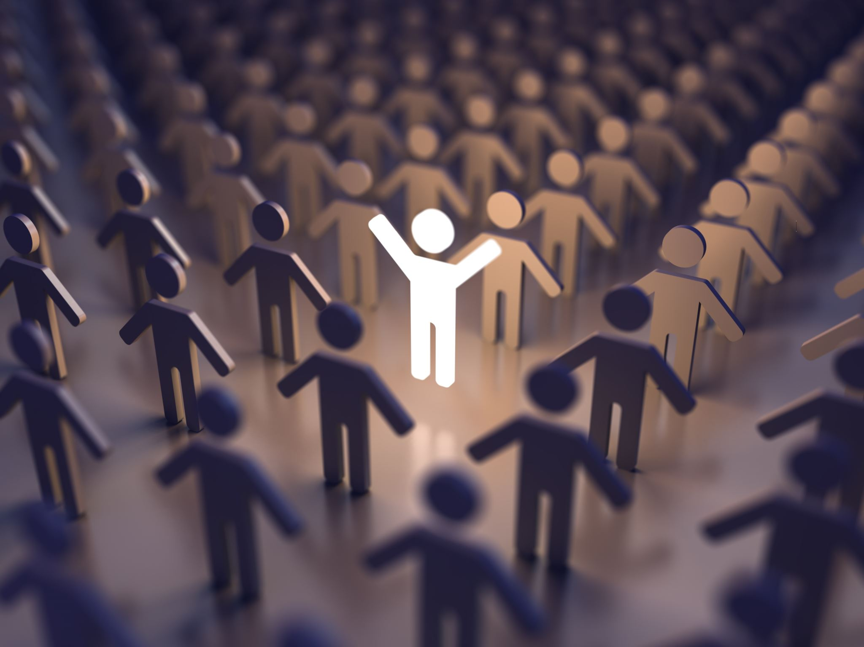
The Conclusion
Very exciting prospects.
Ethical considerations.
Thank you!

